Slide 1
Javascript

Slide 2
Course Objectives
To introduces the web application development using HTML 5, CSS3, JavaScript & XML
To understand tags and API’s Available in HTML 5 and new properties available in the CSS.

Slide 3
Session Plan
Day 1:
History and evolution of the web and HTML
Basic structure of a HTML document and concept of encodings, simplification in HTML5 etc
Fundamentals of HTML5 new tags
Concept of semantic tags and Forms API
Day 2:
Introduction to the 2D Graphics API
Media support
Introduction to CSS3
Day 3:
Introduction to JavaScript
Introduction to XML

Slide 4
Learning material references
HexaGuru+
HTML 5 and JavaScript
Books
JavaScript Bible
John Wiley & sons (US)
JavaScript—A Beginner's Guide, Fourth Edition
McGraw-Hill/Osborne
Web
http://www.w3schools.com/

Slide 5
Introduction to JavaScript
JavaScript is a programming language that can be included on web pages to make them more interactive.
Its is a lightweight programming language that is interpreted by the browser engine when the web page is loaded.
You can use JavaScript to:
Change HTML content
Change HTML attributes
Change HTML styles
Detect visitors' browsers
Validate web form data
etc..

Slide 6
Introduction to JavaScript
JavaScript and Java are completely different languages, both in concept and design.
JavaScript was invented by Brendan Eich in 1995, and became an ECMA standard in 1997.
ECMA-262 is the official name. ECMAScript 5 (JavaScript 1.8.5 - July 2010) is the latest standard.
JavaScript code is written into an HTML page.
Netscape initiative
Initially named as “Livescript”, later renamed to “Javascript”

Slide 7
Introduction to JavaScript
HTML have limited functionality
Text, images, tables, frames
JavaScript allows for interactivity
Browser/page manipulation
Reacting to user actions
A type of programming language
Easy to learn
Developed by Netscape
Now a standard exists – www.ecma-international.org/publications/ standards/ECMA-262.HTM

Slide 8
Introduction to JavaScript
How Java Script Works?
JavaScript is most commonly used as a client side scripting language.
This means that JavaScript code is written into an HTML page (Embedded within HTML page).
When a user requests an HTML page with JavaScript in it, the script is sent to the browser.
When the browser loads the page, the browser has a built-in interpreter that reads the JavaScript code it finds in the page and runs it.
Executes on client (Fast, no connection needed once loaded)
Interpreted (not compiled)

Slide 9
Introduction to JavaScript
Uses of JavaScript
Use it to add multimedia elements
With JavaScript you can show, hide, change, resize images, and create image rollovers. You can create scrolling text across the status bar.
Create pages dynamically
Based on the user's choices, the date, or other external data, JavaScript can produce pages that are customized to the user.
Interact with the user
It can do some processing of forms and can validate user input when the user submits the form.

Slide 10
Introduction to JavaScript
Writing JavaScript
JavaScript code is typically embedded in the HTML, to be interpreted and run by the client's browser. Here are some tips to remember when writing JavaScript commands.
JavaScript code is case sensitive
White space between words and tabs are ignored
Line breaks are ignored except within a statement
JavaScript statements end with a semi- colon (;)

Slide 11
Introduction to JavaScript
The SCRIPT Tag
The <SCRIPT> tag alerts a browser that JavaScript code follows. It is typically embedded in the HTML.
<SCRIPT language = "JavaScript">
Statements
</SCRIPT>

Slide 12
NOSCRIPT Tag
Use the <NOSCRIPT> tag to specify alternate content for browsers that do not support JavaScript.
HTML enclosed within a <NOSCRIPT> tag is displayed by browsers that do not support JavaScript; code within the tag is ignored by Navigator.
Note however, that if the user has disabled JavaScript from the Advanced tab of the Preferences dialog, Navigator displays the code within the <NOSCRIPT> tag.
The following example shows a <NOSCRIPT> tag.
<NOSCRIPT>
<B>This page uses JavaScript, so you need to get Netscape Navigator 2.0
or later!</B>
</NOSCRIPT>
...

Slide 13
Introduction to JavaScript
Implementing JavaScript
There are three ways to add JavaScript commands to your Web Pages.
Embedding code
Inline code
External file

Slide 14
Introduction to JavaScript
External File
You can use the SRC attribute of the <SCRIPT> tag to call JavaScript code from an external text file.
This is useful if you have a lot of code or you want to run it from several pages, because any number of pages can call the same external JavaScript file.
The text file itself contains no HTML tags.
It is call by the following tag:
<SCRIPT SRC="filename.js">
</SCRIPT>

Slide 15
Introduction to JavaScript
Inline JavaScript
Using inline JavaScript allows you to easily work with HTML and JavaScript within the same page.
This is commonly used for temporarily testing out some ideas, and in situations where the script code is specific to that one page.
<script type="text/javascript">
// JavaScript code here
</script>

Slide 16
Introduction to JavaScript
Embedding code
The code will be embedded in the HTML tag itself instead of written in under the script tag.
<a href=“#” onclick=“alert(‘hi’);”>click here </a>

Slide 17
Data Types
Numbers
1, 3.14159, -99
Logical (Boolean) values
true or false
Strings
“hello”, ‘hello’
null
special keyword denoting null value

Slide 18
String Literals
A string literal is zero or more characters enclosed in double (") or single (') quotes. A string must be delimited by quotes of the same type; that is, either both single quotes or double quotes. The following are examples of string literals:
"Hello"
'Hello'
"1234"
“one line \n another line”
'"Don\'t try that again!," I yelled.'

Slide 19
Introduction to JavaScript
Variables
Variables are used to store data.
A variable is a "container" for information you want to store. A variable's value can change during the script. You can refer to a variable by name to see its value or to change its value.
Rules for variable names:
Variable names are case sensitive
They must begin with a letter or the underscore character
strname – STRNAME (not same)

Slide 20
Variables
JavaScript is a loosely typed language.
myVar = 33;
myVar = “Hello World”;
myVar = 33 + “Hello World”; // gets “33Hello World”
myVar = “Hello World” + 33; // gets “Hello World33 ”

Slide 21
Introduction to JavaScript
Variables
To declare variables, use the keyword var and the variable name:
var userName
To assign values to variables, add an equal sign and the value:
var userName = "Smith"
var price = 100

Slide 22
Introduction to JavaScript
More Syntax
var Variablename = value;
var x = 3;
var name = “ISU”;
var x, y = 0;
var x = null;
Note: Null is: 0 (number), false (Boolean)
There is no way to specify that a particular variable represents an integer, a string or a floating-point (real) number.

Slide 23
Variable Names
A JavaScript identifier or name must start with a letter or underscore ("_"); subsequent characters can also be digits (0-9).
Letters include the characters "A" through "Z" (uppercase) and the characters "a" through "z" (lowercase). JavaScript is case-sensitive.
Some examples of legal names are:
Last_Name
status
_name

Slide 24
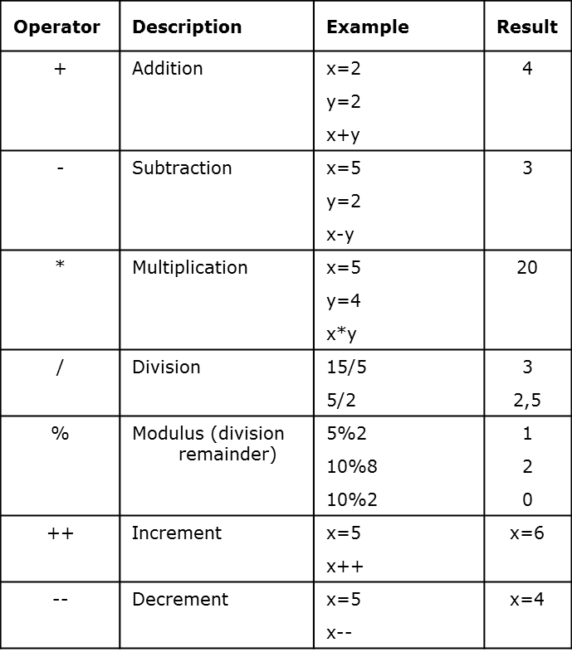
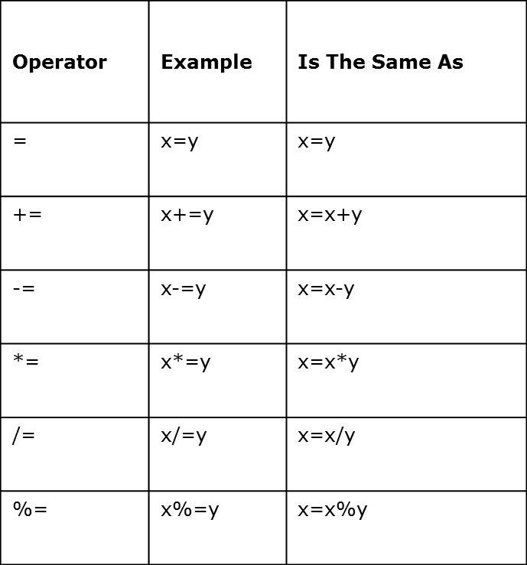
JavaScript Operators

Slide 25
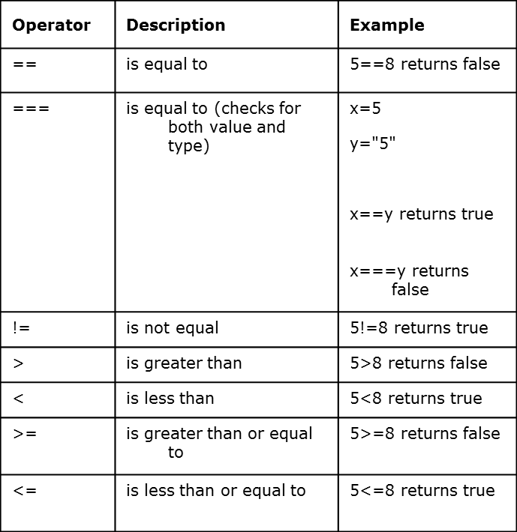
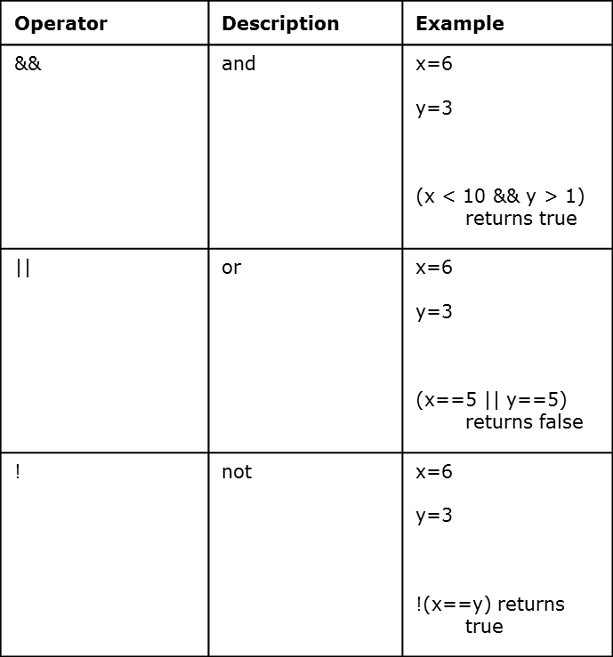
JavaScript Operators

Slide 26
JavaScript Popup Boxes
JavaScript has built-in functions for several predefined operations.
Here are some functions which is used for Pop up boxes.
alert("message")
confirm("message")
prompt("message")

Slide 27
JavaScript Popup Boxes
Alert Box
An alert box is often used if you want to make sure information comes through to the user.
When an alert box pops up, the user will have to click "OK" to proceed.
<script>
alert("Hello World!")
</script>

Slide 28
JavaScript Popup Boxes
Confirm Box
A confirm box is often used if you want the user to verify or accept something.
When a confirm box pops up, the user will have to click either "OK" or "Cancel" to proceed.
If the user clicks "OK", the box returns true. If the user clicks "Cancel", the box returns false.

Slide 29
JavaScript Popup Boxes
Prompt Box
A prompt box is often used if you want the user to input a value before entering a page.
When a prompt box pops up, the user will have to click either "OK" or "Cancel" to proceed after entering an input value.
If the user clicks "OK“, the box returns the input value. If the user clicks "Cancel“, the box returns null.

Slide 30
Introduction to JavaScript
Objects
JavaScript supports programming with objects. Objects are a way of organizing the variables. The different screen elements such as Web pages, forms, text boxes, images, and buttons are treated as objects.
Properties and Methods
Every object has its own properties and methods.
Properties define the characteristics of an object
Ex. color, length, name, height, width
Methods are the actions that the object can perform or that can be performed on the object.
Ex. alert, confirm, write, open, close

Slide 31
Objects in a Page
Every page has the following objects:
navigator: has properties for the name and version of the Navigator being used, for the MIME types supported by the client, and for the plug-ins installed on the client.
window: the top-level object; has properties that apply to the entire window. There is also a window object for each "child window" in a frames document.
document: contains properties based on the content of the document, such as title, background color, links, and forms.
location: has properties based on the current URL.
history: contains properties representing URLs the client has previously requested.
Depending on its content, the document may contain other objects.
For instance, each form (defined by a FORM tag) in the document has a corresponding Form object.

Slide 32
Introduction to JavaScript
Naming Objects
Objects are organized in a hierarchy. To refer to an object use :
objectName
To refer to a property of an object use:
objectName.propertyName
To refer to a method of an object use:
objectName.methodName()

Slide 33
Introduction to JavaScript - Document Object
The Document object represents the Web page that is loaded in the browser window, and the content displayed on that page, including text and form elements.
Document Methods
You can use the methods of the document object to work on a Web page.
Here are the most common document methods:
write() - write a string to the Web page
open() - opens a new document
close() - closes the document

Slide 34
Introduction to JavaScript - Document Object
Document Properties
Use the properties of the document object to set the colors of the page, the title and display the date the document was last modified. JavaScript has about 150 defined color words you can use or you can provide the hexadecimal RGB codes.
Here are the most common document properties:
bgColor
fgColor
linkColor
vlinkColor
title
lastModified

Slide 35
Introduction to JavaScript - Window Object
The window object represents the browser window. You can use it to open a Web page in a new window and to set the attributes for the window. There are only two main window properties. They are:
status - set the status bar message
self - stores the name mof the current window
Window Methods
The window methods are mainly for opening and closing new windows. The following are the main window methods. They are:
alert() - to display a message box
confirm() - to display a confirmation box
prompt() - to display a prompt box
open() - to open a new window
close() - to close a window

Slide 36
Introduction to JavaScript - Window Object
Window Attributes
If the default new window does not suit your needs, you can specify different features of the window when you open it. The complete syntax of the "window.open" is as follow:
window.open(URL, windowName, featureList)
By default, if you do not specify any features, then a window will have all of them. If you specify any one feature, then the window will have only those you set equal to 1.

Slide 37
Statements
Variable Declaration / Assignment
Function Definition
Conditionals
Loops
with statement
Comments

Slide 38
Comments
// Single Line
var x // this part of the line is a comment
/* Multiline Comment
Line 2.....
Line 3 */

Slide 39
JavaScript Basic Examples
<script>
document.write("Hello World!")
</script> ⇒ format text with HTML code - heading
<script>
alert("Hello World!")
</script>

Slide 40
Example
<script>
x=“Hello World!”
document.write(“welcome” + x)
</script>

Slide 41
Conditional Statements
Very often when you write code, you want to perform different actions for different decisions. You can use conditional statements in your code to do this.
In JavaScript we have the following conditional statements:
if statement - use this statement if you want to execute some code only if a specified condition is true
if...else statement - use this statement if you want to execute some code if the condition is true and another code if the condition is false
if...else if....else statement - use this statement if you want to select one of many blocks of code to be executed
switch statement - use this statement if you want to select one of many blocks of code to be executed

Slide 42
Conditional Statements - 2
if (condition)
{
code to be executed if condition is true
}
if (condition)
{
code to be executed if condition is true
}
else
{
code to be executed if condition is not true
}

Slide 43
Conditional Statements Examples
<script>
x=3
if(x<0)
{
alert (“Negative”)
}
else
{
alert (“Positive”)
}
</script>

Slide 44
Conditional Statements Examples
<script>
c=confirm(“Do You Want to Continue”)
if(c)
{
alert (“Welcome”)
}
else
{
alert (“Thank You”)
}
</script>

Slide 45
Conditional Statements Examples
<script>
p=prompt(“Enter the Value", " ")
if(p=="06")
{
alert(“Welcome")
}
else
{
alert(“Thank you")
}
</script>

Slide 46
Loops
Syntax
for ([initial expression]; [condition]; [update expression]) {
statements
}
Example
for (var i = 0; i < 10; i++) {
document.write(i);
}
Exercise 8, 9

Slide 47
Introduction to JavaScript
Functions
With functions, we can give a name to a whole block of code, allowing us to reference it from anywhere in your program.
With user-defined functions, we can name a block of code and call it when we need it.
You define a function in the HEAD section of a web page. It is defined with the function keyword, followed by the function name and any arguments.
function functionName(argument)
{
Statements;
}

Slide 48
Functions
Example
// Takes an endValue and returns 1+2+3+ … + endValue
function summation (endVal) {
var thesum=0;
for ( var iter = 1; iter <= endVal; iter++ )
thesum += iter;
return ( thesum );
}
answer = summation(5);

Slide 49
Arguments and Parameters
<SCRIPT LANGUAGE="JavaScript">
<!-- to hide script contents from old browsers
function square(i) {
document.write("The call passed “+ i + " to the function.“+"<BR>")
return i * i
}
document.write("The function returned “+square(8)+".")
// end hiding contents from old browsers -->
</SCRIPT>

Slide 50
Arguments and Parameters
FileName: argument.htm
<SCRIPT LANGUAGE="JavaScript">
<!-- to hide script contents from old browsers
function square(i) {
document.write("The call passed “+ i + " to the function.“+"<BR>")
return i * i
}
document.write("The function returned “+square(8)+".")
// end hiding contents from old browsers -->
</SCRIPT>

Slide 51
Event Handling

Slide 52
Event Handling
JavaScript provides a moderate level of event detection to pass control to functions attached to built-in event handlers
e.g.,
<INPUT type=“button” VALUE=“button1”
onClick=“computeSomething()”>
Events are triggered in the browser primarily by user actions such as button click, page load, form submit.

Slide 53
Event Handlers
The following event handlers are available in JavaScript:
onAbort
onBlur
onChange
onClick
onDragDrop
onError
onFocus
onKeyDown
onKeyPress
onKeyUp
onLoad
onMouseDown
onMouseMove
onMouseOut
onMouseOver
onMouseUp
onMove
onReset
onResize
onSelect
onSubmit
onUnload

Slide 54
Event Handlers (Cont...)
onAbort
An abort event occurs when a user aborts the loading of an image (for example by clicking a link or clicking the Stop button)
onBlur
A blur event occurs when a select, text, or textarea field on a form loses focus.
onChange
A change event occurs when a select, text, or textarea field loses focus and its value has been modified.
onClick
A click event occurs when an object on a form is clicked.

Slide 55
Event Handlers (Cont...)
onDragDrop
A drapDrop event occurs when a user drops an object onto the browser window, such as dropping a file on the browser window
onError
An error event occurs when the loading of a document or image causes an error
onFocus
A focus event occurs when a field receives input focus by tabbing with the keyboard or clicking with the mouse.
onKeyDown, onKeyPress, onKeyUp
A keyDown, keyPress, or keyUp event occurs when a user depresses a key, presses or holds down a key, or releases a key, respectively

Slide 56
Event Handlers (Cont...)
onLoad
A load event occurs when Navigator finishes loading a window or all frames within a <FRAMESET>.
Examples
In the following example, the onLoad event handler displays a greeting message after a web page is loaded.
<BODY onLoad="window.alert('Welcome to my home page!')">
onMouseDown, onMouseMove, onMouseOut, onMouseOver, and onMouseUp
A MouseDown, MouseMove, MouseOut, MouseOver, or MouseUp event occurs when a user depresses a mouse button, moves a cursor, moves a cursor out of a link or image map, moves a cursor over a link, releases a mouse button, respectively

Slide 57
Event Handlers (Cont...)
onMouseOver
A mouseOver event occurs once each time the mouse pointer moves over an object from outside that object.
Example
<A HREF="http://www.ilstu.edu/"
onMouseOver="window.status=‘A Good Place …!'; return true">
Click me</A>
Return true tells the browser not to perform its own
event handling routine of displaying the link’s URL
in the status bar

Slide 58
Event Handlers (Cont...)
OnResize
A Resize event occurs when a user or script resizes a window
<html>
<head>
<script language="JavaScript">
window.onresize= message;
function message() {
alert("The window has been resized!");
}
</script>
</head>
<body>
Please resize the window.
</body>
</html>

Slide 59
Event Handlers (Cont...)
Another look at onClick:
<body>
<form name="myForm">
<input type="button" name="myButton" value="ClickMe!" >
</form>
<script language="JavaScript">
document.myForm.myButton.onClick= message;
function message() {
alert('Click event occured!');
}
</script>
</body>

Slide 60
Event Handlers (Cont...)
onSelect
A select event occurs when a user selects some of the text within a text or textarea field.
onSubmit
A submit event occurs when a user submits a form
onUnload
An unload event occurs when you exit a document.

